Slide 1
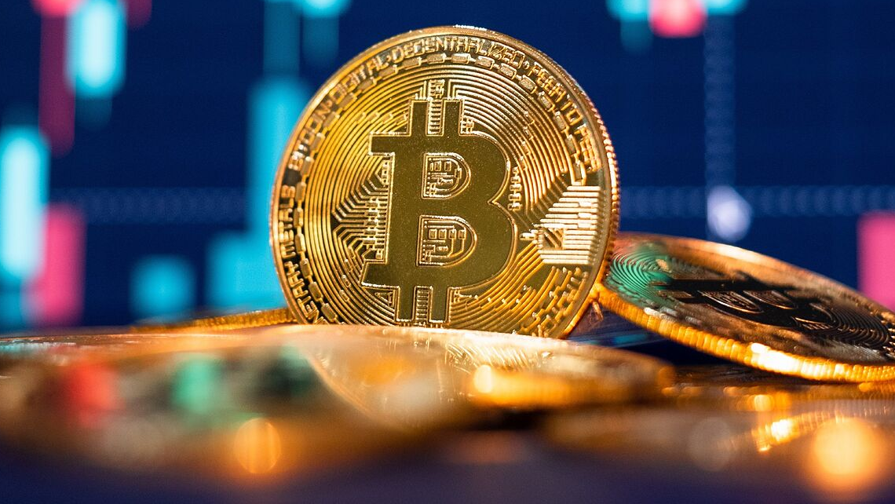
Does Bitcoin Threaten Economic Stability? [C3]
Group C: Eddie, Francis, Hendy, Jodie & Keegan
Image extracted from: https://www.marca.com/en/lifestyle/us-news/2022/01/07/61d84ebd46163fe3358b45c4.html

Slide 2
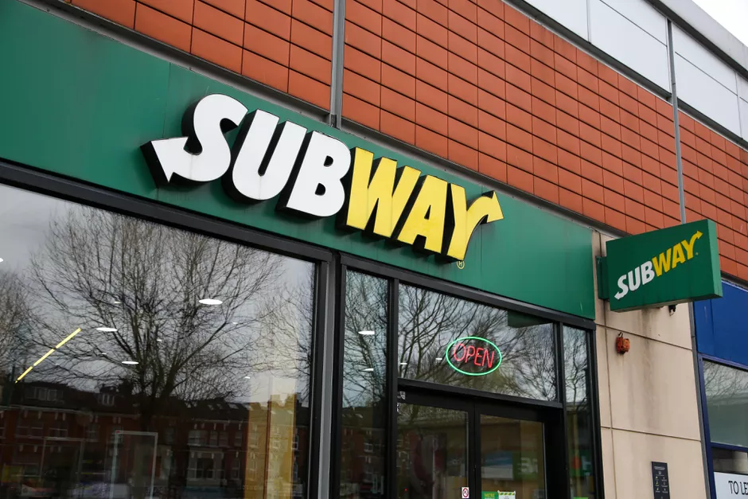
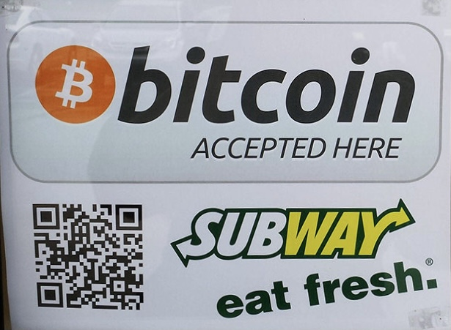

USA
Images extracted from: https://www.cnet.com/how-to/subway-tuna-sandwich-dna-results-the-controversy-explained/ https://www.coindesk.com/markets/2013/11/12/bitcoin-accepting-subway-sandwich-shop-discovered-in-the-us/

Slide 3
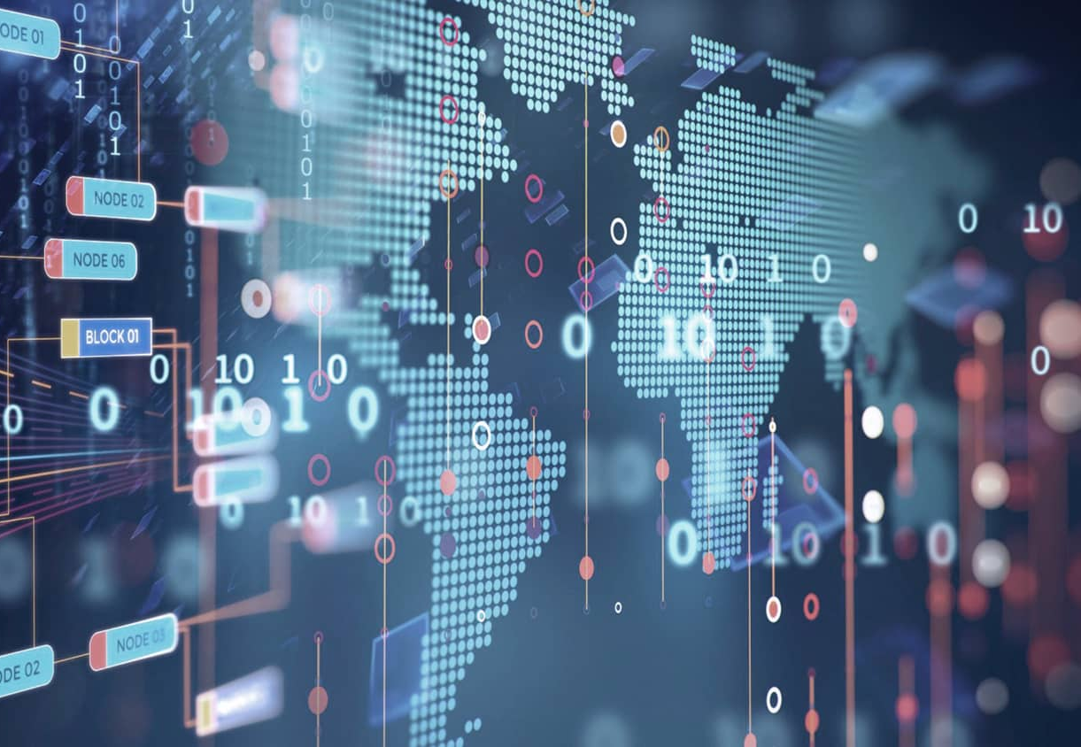

Introduction to Bitcoin
Distributed, decentralised digital currency system
Not regulated by central authority
Peer-to-peer technology
Bitcoin miners provide computing power to process bitcoin transactions
Uses blockchain technology
Data stored across a huge network of computers instead of a central server
Satoshi Nakamoto
Images extracted from: https://www.coindesk.com/markets/2013/11/12/bitcoin-accepting-subway-sandwich-shop-discovered-in-the-us/ http://clipart-library.com/images_k/person-clipart-transparent/person-clipart-transparent-24.png
Notes:
http://clipart-library.com/images_k/person-clipart-transparent/person-clipart-transparent-24.png

Slide 4
Low transaction fees
Only Bitcoin’s blockchain network fees during transactions
Cheaper than bank transfers as no government involvement
Speedier processing
Fast international payment
Eliminates inconvenience of authorisation requirements and wait periods
Advantages
Decentralised Monetary System
Immune to sovereign censorship, shutdown, confiscation and unnatural inflation when the government print more money
Mobile payment
Make payment anywhere
Personal information not required

Slide 5
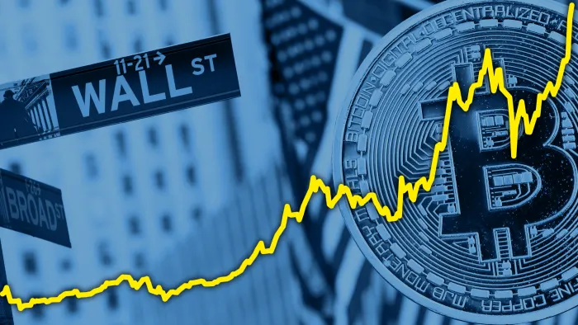

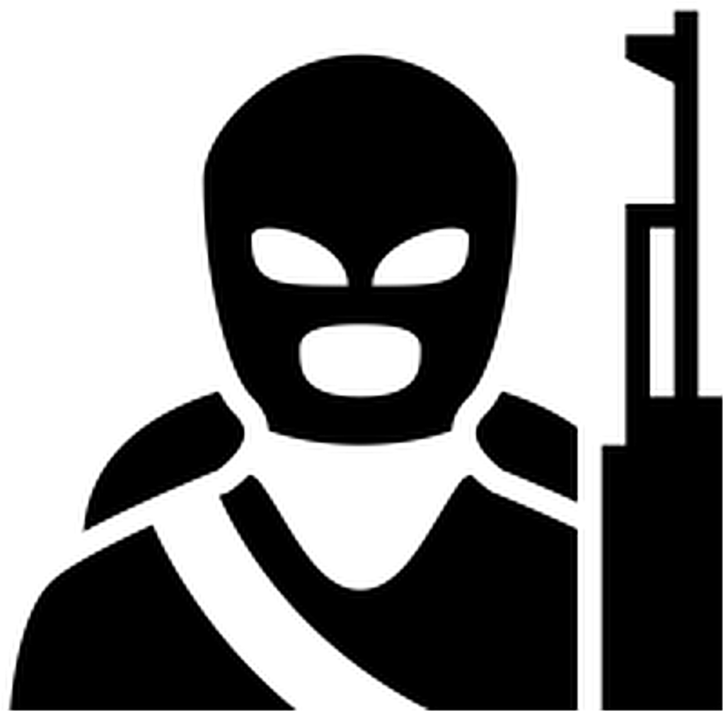
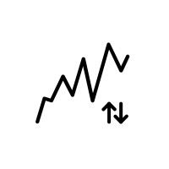

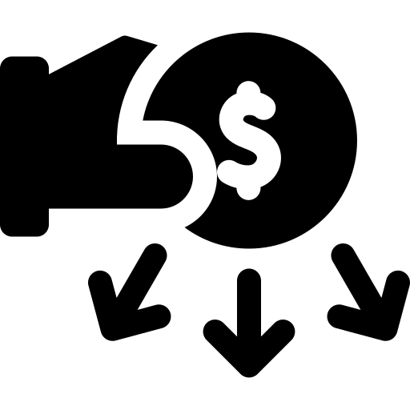

Why Bitcoin Threatens Economic Stability
Money Laundering
Terrorist Financing
Volatility
No government nor international regulations
No corresponding liability
Makes existing systems obsolete
Image extracted from: https://www.ft.com/content/67dc75fc-b29e-11e7-a398-73d59db9e399
Notes:
Money laundering: https://www.flaticon.com/free-icon/money-laundering_1285613
Terrorist: https://www.pngkey.com/maxpic/u2y3q8e6w7e6i1o0/
Volatile: https://thenounproject.com/icon/volatile-2955277/
Government: https://commons.wikimedia.org/wiki/File:Government_icon_(black).svg
Liability: https://www.flaticon.com/free-icon/liability_2780211
Obsolete: https://thenounproject.com/icon/obsolete-2014018/

Slide 6
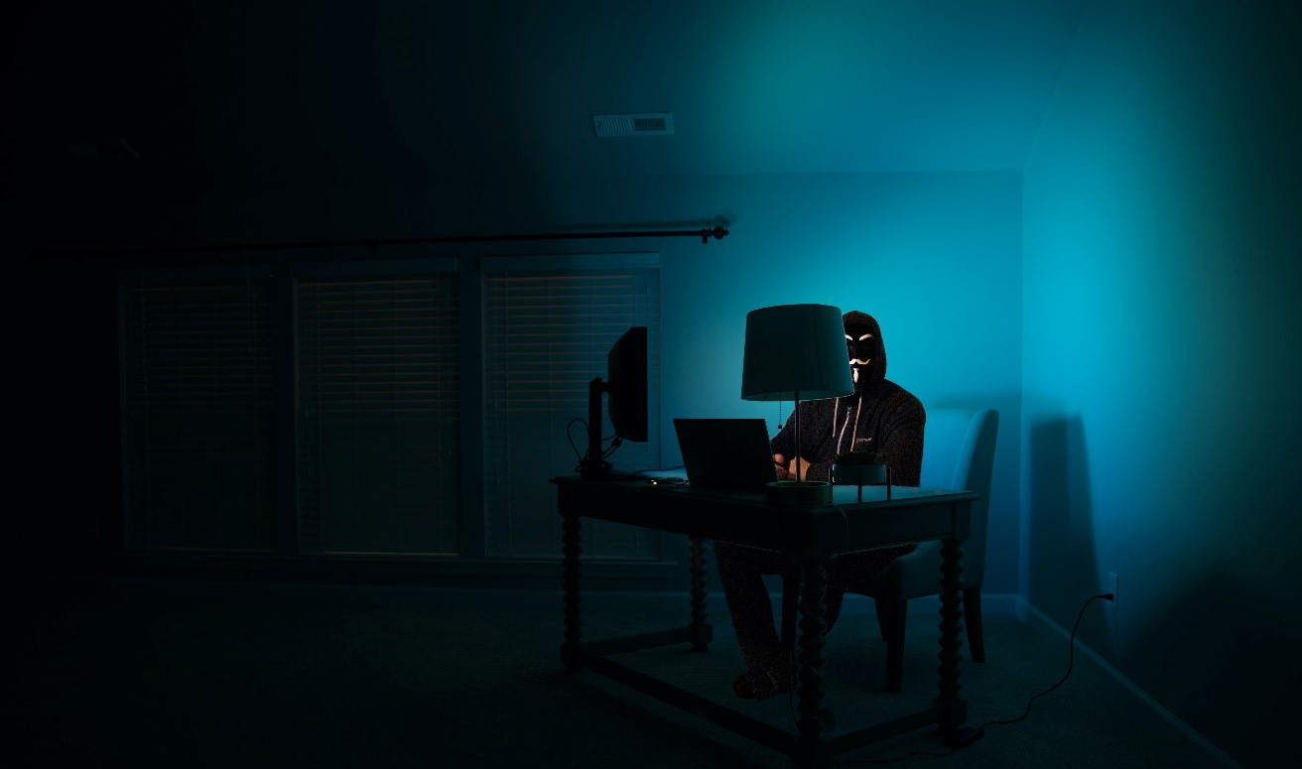
Example - ‘Silk Road’
Bitcoin was used as the currency of choice in ‘Silk Road’, a ‘dark web’ marketplace for illegal goods was shut down by US law enforcement authorities in 2013 and caused economic instability.
Image extracted from: https://www.kaspersky.com/resource-center/threats/deep-web
Notes:
Dark web: https://www.kaspersky.com/resource-center/threats/deep-web

Slide 7
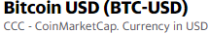
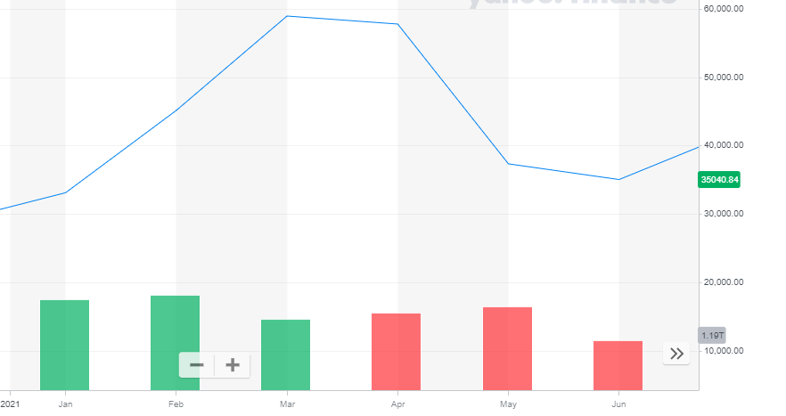
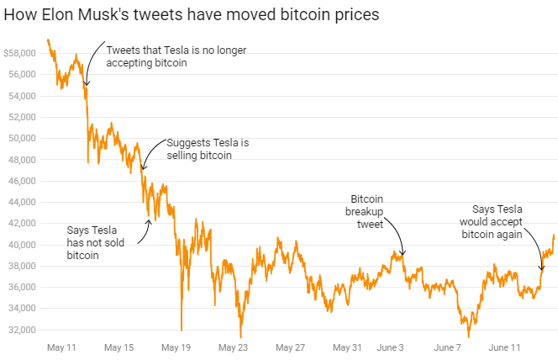
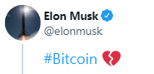

Image extracted from: https://twitter.com/elonmusk
Example - Impact of Elon Musk’s Tweets on Bitcoin

Slide 8
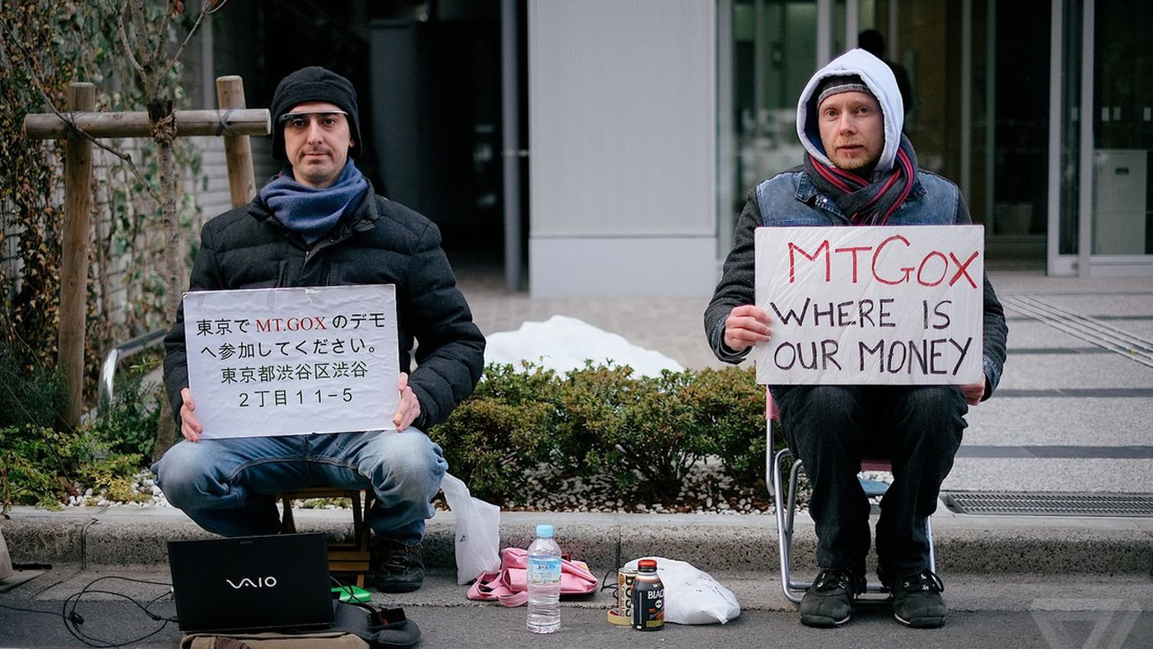
Example - MT.GOX Loses Bitcoin
MT.GOX served as a bitcoin exchange platform. In 2013, it was handling over 70% of all bitcoin transactions worldwide, as the largest bitcoin intermediary and the world's leading bitcoin exchange. before it was shutdown in 2014. Due to bitcoins belonging to customers and the company went missing.
Image extracted from: https://www.theverge.com/2018/3/22/17151430/bankruptcy-mt-gox-liabilities-bitcoin

Slide 9

Africrypt, an obscure cryptocurrency investment operation run by Raees and Ameer Cajee, age 21 and 18 disappeared, after a local law firm involved in recovery efforts said the brothers had made off with 69,000 bitcoin.
Example - Disappearance of Africrypt’s Founders
Image extracted from: https://luxurylaunches.com/other_stuff/africrypt-cryto-currency-heist.php

Slide 10

No corresponding liability
No institution (central banks nor government) with vested interests to sustain the value
Bitcoin Impact on
Financial System
Change of existing financial systems to accommodate
May render current financial service providers obsolete
Image extracted from: https://pixie.digital/proving-value-content-marketing-boss/

Slide 11
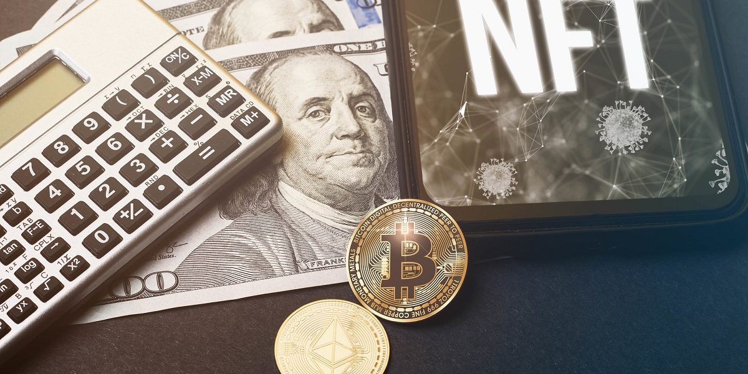


Lack of Control and Regulation of Bitcoin
No international law to regulate bitcoin
Difficult to trace bitcoin transactions due to lax reporting requirements
Tax evasion (Income tax/Corporate tax)
State has no control over cryptocurrency
No uniform international laws regulating Bitcoin
Image extracted from: https://www.thetechherald.com/tech-news/cryptocurrency-community-in-america-divided-and-outraged-over-new-and-tighter-tax-compliance-regulation-will-proof-of-work-or-proof-of-stake-syst/
Notes:
State: https://thewire.in/tech/amid-cryptocurrency-boom-and-no-regulation-whats-the-way-forward-for-indias-policymakers
Law: https://www.freepik.com/free-icon/law_731110.htm

Slide 12

Lesson Learnt
Be aware of the risks involved before using Bitcoins
Bitcoin is still in its infancy stage
Need time before appropriate regulations are implemented
New technologies would inevitably come with their new set of problems
Engineer’s job to solve and overcome the challenges surfaced
Notes:
Bulb: https://similarpng.com/illustration-of-light-bulb-icon-on-transparent-background-png/#getdownload

Slide 13


Slide 14
REFERENCES
Sotiropoulou, A., & Guégan, D. (2017). Bitcoin and the challenges for financial regulation. Capital Markets Law Journal, 12(4), 466-479. http://dx.doi.org/10.1093/cmlj/kmx037
Hern, Alex. (2013, Oct 3). Bitcoin price plummets after Silk Road closure. Guardian. https://www.theguardian.com/technology/2013/oct/03/bitcoin-price-silk-road-ulbricht-value
Molla, Rani. (2021, Jun 14). How Elon Musk affects bitcoin prices, in one chart. When Elon Musk tweets, crypto prices move https://www.vox.com/recode/2021/5/18/22441831/elon-musk-bitcoin-dogecoin-crypto-prices-tesla
Malik, Nikita. (2018, Nov 16). Is Bitcoin A Credible Payment System For Terrorists?. Forbes. https://www.forbes.com/sites/nikitamalik/2018/11/16/is-bitcoin-a-credible-payment-system-for-terrorists
Harney, Alexander. (2017, Nov 16). MT GOX. Reuters Investigates. https://www.reuters.com/investigates/special-report/bitcoin-gox/
Vallance, Chris. (2021, June 25). Africrypt brothers deny involvement in Bitcoin 'heist' .BBC. https://www.bbc.com/news/technology-57582805
Kethineni, S., & Cao, Y. (2020). The rise in popularity of cryptocurrency and associated criminal activity. International Criminal Justice Review, 30(3), 325-344.x

Slide 15
?
Q & A

